Slide 1
2024 Community Health Improvement Plan Annual Report
Rayona LaVoie, Director of Programs and Projects
Office of the District Health Officer

Slide 2
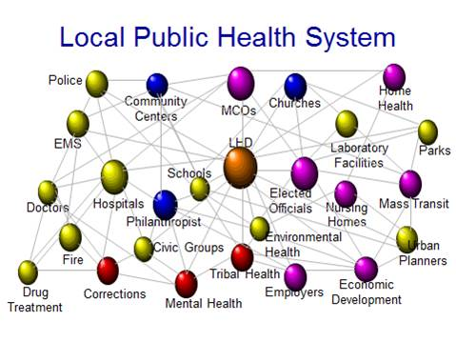

What is a CHIP?
Key Elements
Data-driven approach.
Inclusion of community and partner perspectives.
A systematic plan to improve health outcomes for a community.
Based on local data, needs, and high-priority health issues.

Slide 3

Why is the CHIP Important for Improving Health Outcomes?
Data-Informed Strategy:
Focuses on the specific health needs of the community.
Uses evidence-based practices to identify and address issues.
Collaborative Approach:
Public health systems, healthcare providers, nonprofits, schools, and local government work together.
Leverage expertise from various sectors for sustainable change.
Coordinating Services:
Coordinates services and programs across different sectors to improve continuity of care and the use of resources.
Reduces duplication and ensures that community needs are met holistically.

Slide 4
CHA-CHIP Process
641 Community Survey responses collected
1 community conversation
Developed a CHIP
16
Focus Groups
27 sessions
7
Steering Committee Meetings
Identified Initiatives
Evaluate CHIP activities
103 Community indicators
Data
process applied
Inform
Collect
Organize
Listen
Prioritize
Community Health Assessment
Listening Tour
CHIP
Stakeholders informed the process
Quantitative and Qualitative data gathered to determine health outcomes in Washoe County
Ranked important health issues in the community
Engaged targeted communities to understand health disparities
Collectively identified priority areas and interventions

Slide 5






Improving Health Outcomes Through Collaboration and Investment
Year 1 Implementation: Jan 1- Dec 31, 2023
Year 2 Implementation: : Jan 1- Dec 31, 2024
Year 3 Implementation: Jan 1- Dec 31, 2025
71%
Social Determinants of Health
Status: Actions Achieved
Access to Health Care
Status: Actions Achieved
Preventative Health Behaviors
Status: Action in Progress
Mental Health
Status: Action in Progress

Slide 6
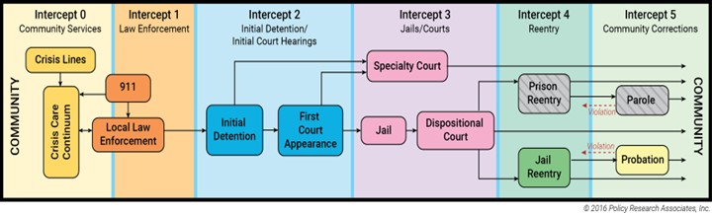
Improving Community Health Through Partnerships
Priority Area: Mental Health
Washoe County Regional Crisis Response System
Sequential Intercept Model (SIM)
Aca Entre Nos
Washoe Suicide Prevention Alliance
01
02
03
04
Crisis Care Center Opened
Multiple MOUs between system partners have been completed
Data summary published
Framework and action plans completed
Facilitated 4 AEN sessions
Established partnership with WCSD
Launched Temporary Gun Storage Map with four (4)
Expanded partnerships

Slide 7
Improving Community Health Through Partnerships
Priority Area: Preventative Health Behaviors
Rx Pantry
Anything But The Gym
5210 Healthy Washoe
Healthy Corner Store Project
01
02
03
04
Increased prescription redemption by 32%
Integrated 5210 messaging into Rx Pantries
62% of participants improved their knowledge about using PA as pathway to reduce anxiety and stressful behaviors
Expanded program
Improved cafeteria environments
Expanded outreach to Ethnic Markets
Increase participation in priority zip codes

Slide 8
Improving Community Health Through Partnerships
Priority Area: Social Determinants of Health
Un Plan Financiero para Abrir Puertas
Language Access
Golden Groceries
01
02
03
10 Financial Literacy Classes Provided
83 Community Members Reached
Developed process for document translation
Improving service delivery through Wordly.ai and Language Line
682 Seniors served monthly
increased in 2024
Fewer Seniors are skipping meals

Slide 9
Improving Community Health Through Partnerships
Priority Area: Access to Health Care
Family Health Festivals
AB45 Loan Repayment
01
02
Over 400 households connected to resources
Expanding partnerships
Promoted resources to support the Nevada Health Equity & Loan Assistance (HEAL) Program

Slide 10
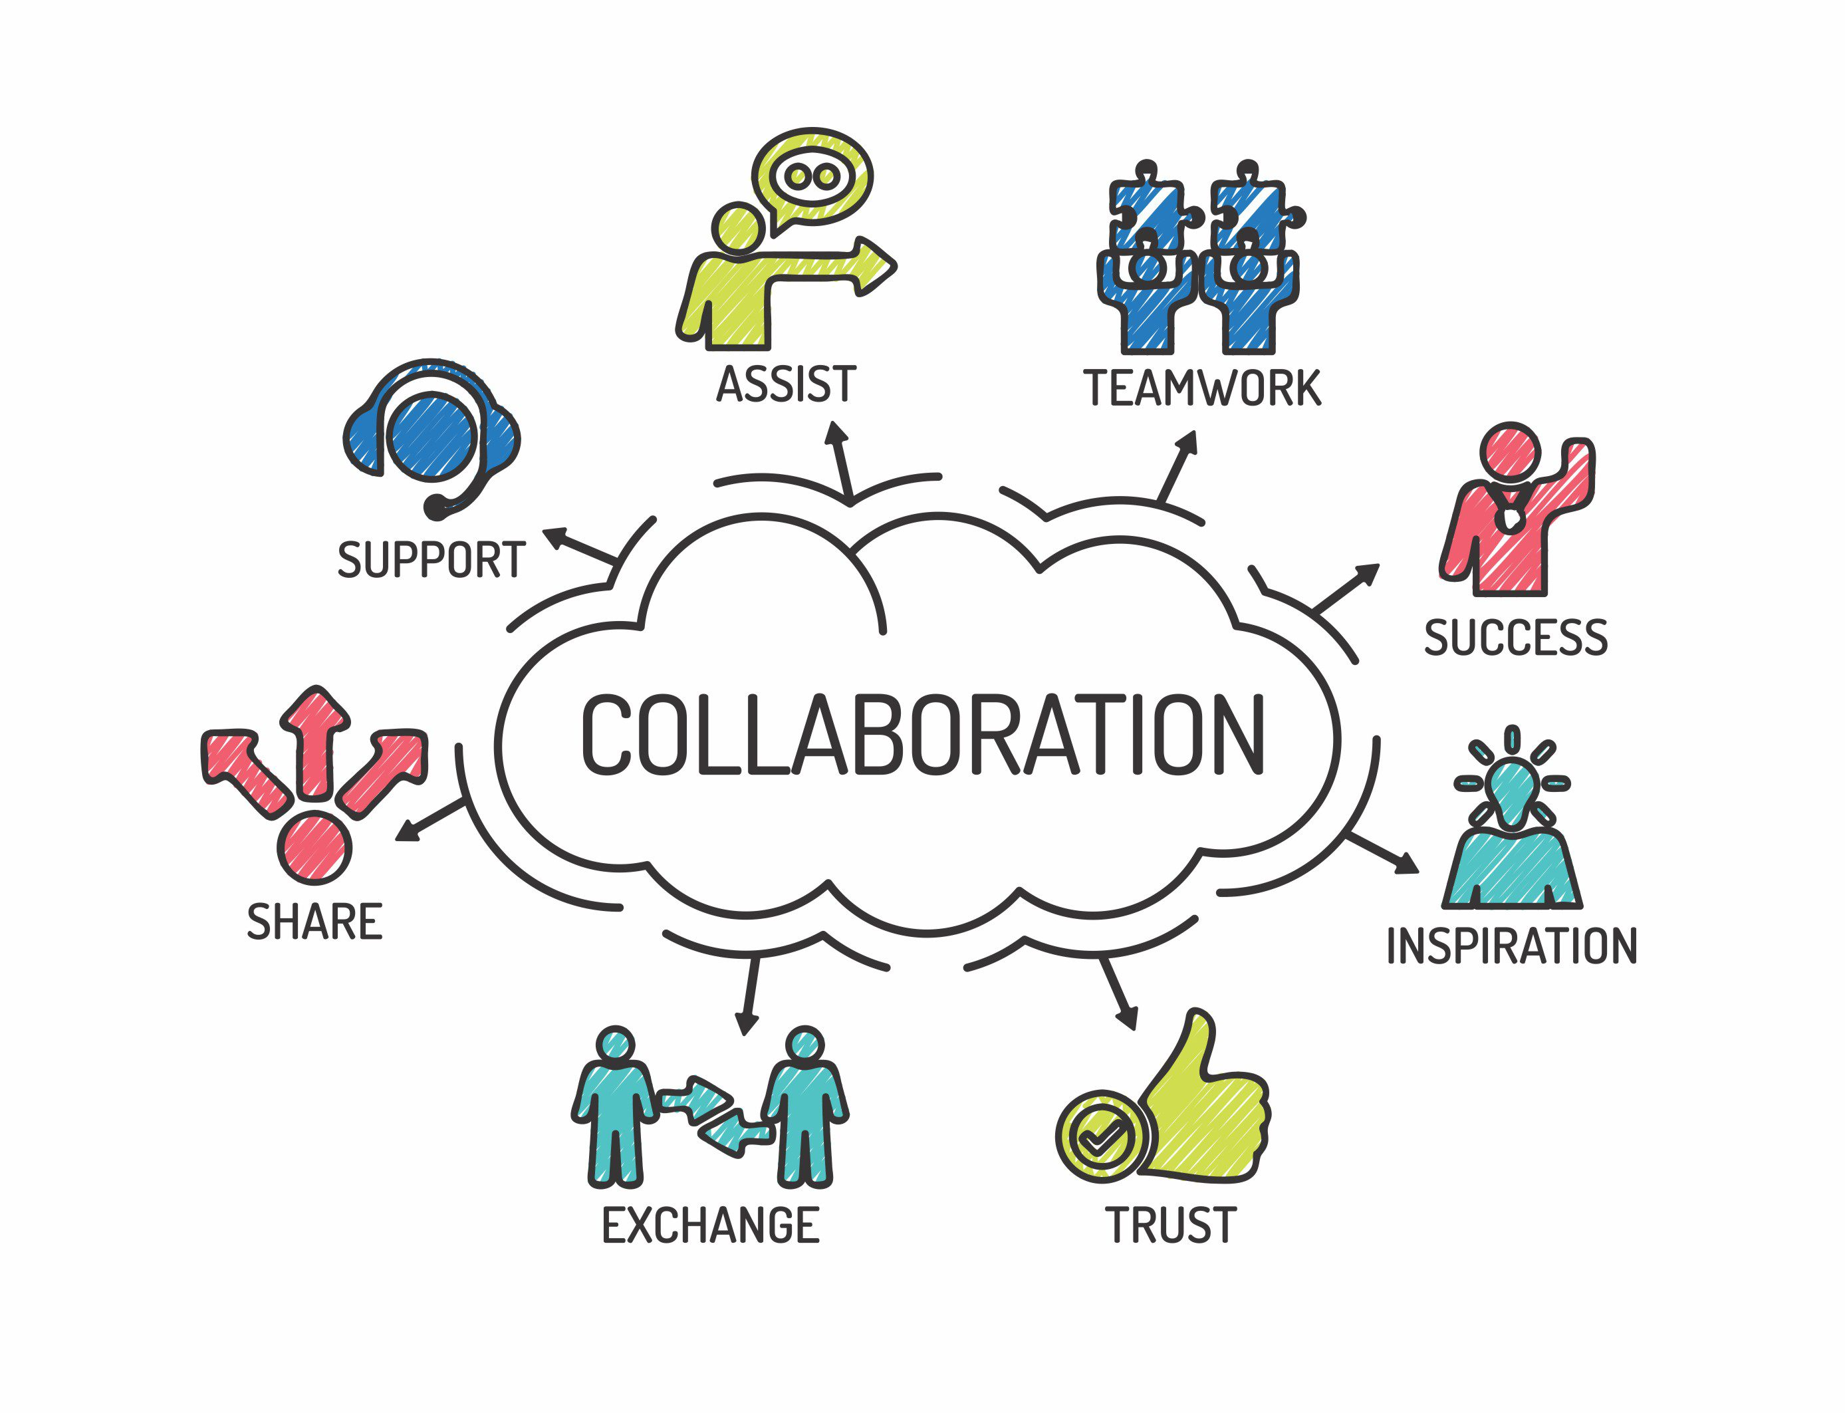
Opportunities for Further Collaboration
Expand loan repayment options.
Improve muti-tiered systems of support to prevent youth crisis events.
Establishing prenatal care in the first trimester among minority populations.
Addressing substance use among pregnant and postpartum individuals.
Advance Community Health Worker models and paraprofessionals to deliver navigation and improved services in low-resource settings.
Improved coordination among nutrition partners to support Washoe County School District’s Wellness Policy.
Increase prevention efforts to mitigate late-stage conditions.
Increase awareness of preventative health behaviors and their importance among minority populations.

